Slide 1
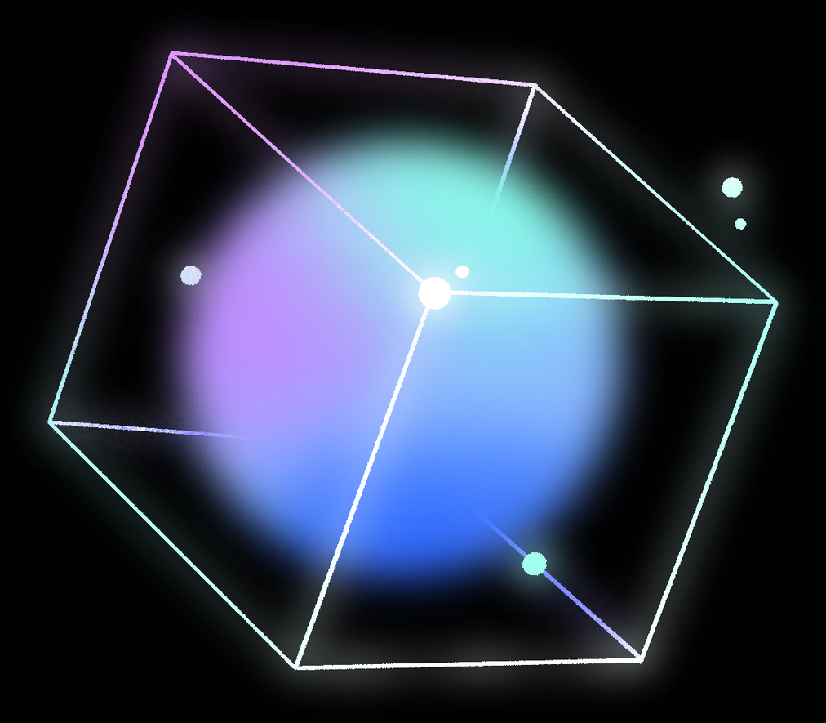

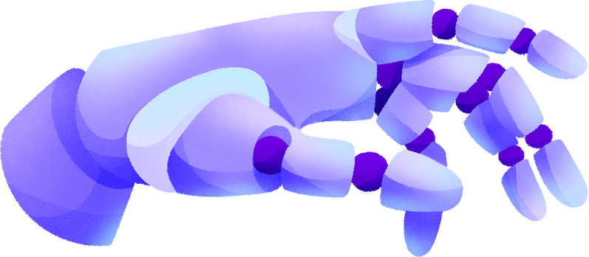


Brain Tumor Detection
By Rule of Thirds

Slide 2


Procedure
01
02
03
04
Used dataset containing multiple views of ~7000 RGB MRI brain scans
Pre-processed the data to ensure uniformity and append classification values
Used PyTorch’s functionality to build and train our Custom CNN
Used a training/validation/testing split to do validation training.
Notes:
explain CNN at 3

Slide 3

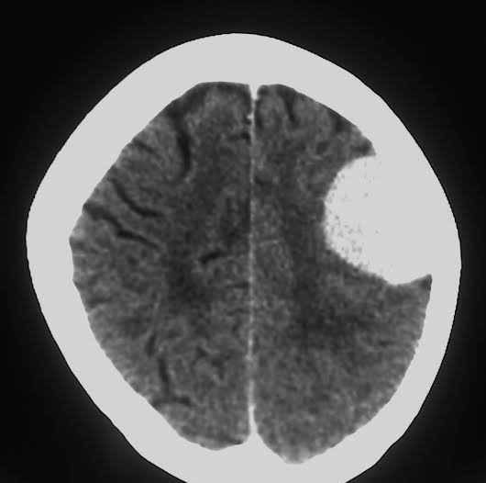
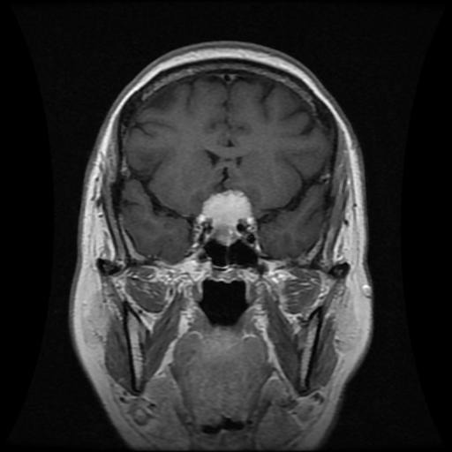

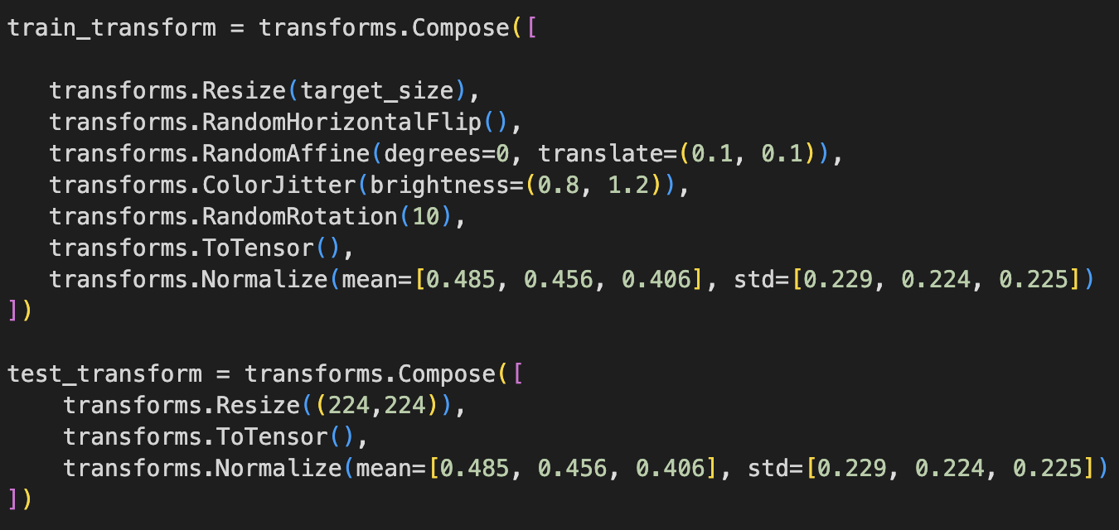
Data Preprocessing
80-20 split of the dataset for the train and test set respectively.
Test set was split in halves for the validation set.
Assigned numerical values to different scans.
Resizes all images into 224x224 into a set size and sets to grayscale.
Applied random transformations to the training set to increase diversity and reduce overfitting.

Slide 4
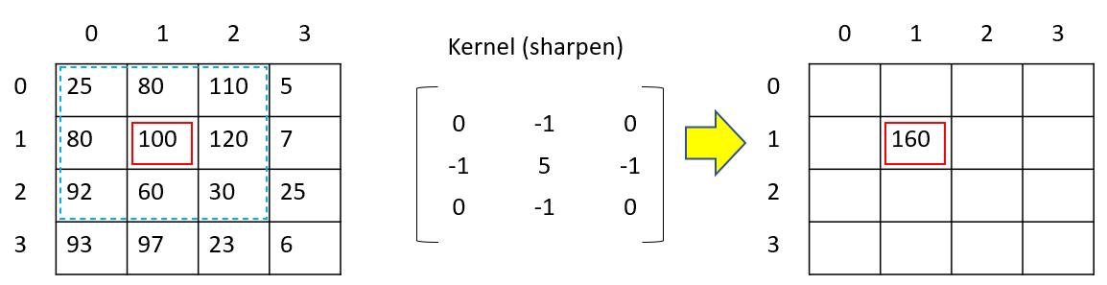
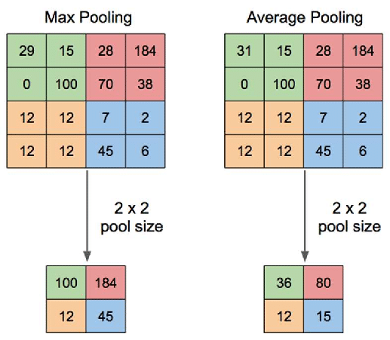
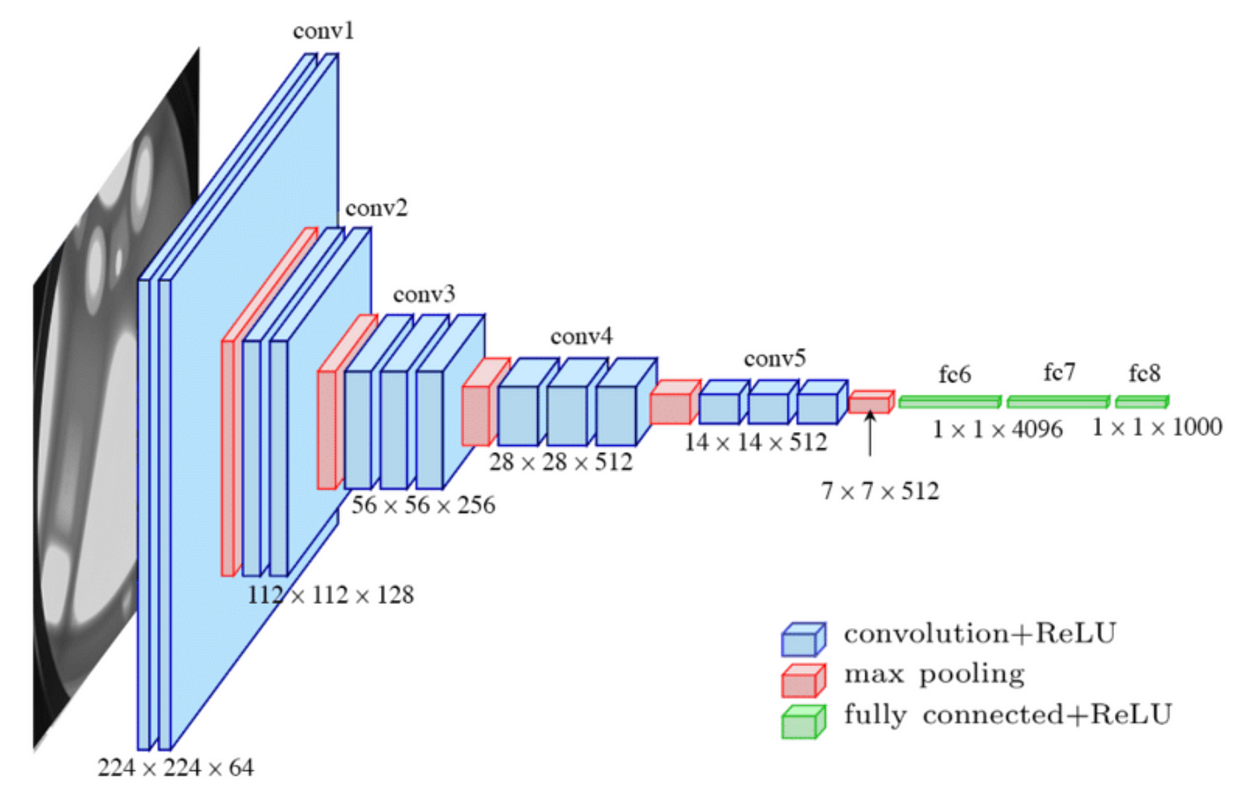
Understanding our CNN
CNN stands for Convolutional Neural Networks.
It is a deep learning model mainly used to process images.
It does so through filters which extract features that can then be used to classify the image
Convolution Layers: Extract features by applying filters to the input. Our model has five convolution layers.
Linear Layers: reduces image size, while maintaining the important features.
Notes:
features like edges, shapes, textures, colors, etc.

Slide 5
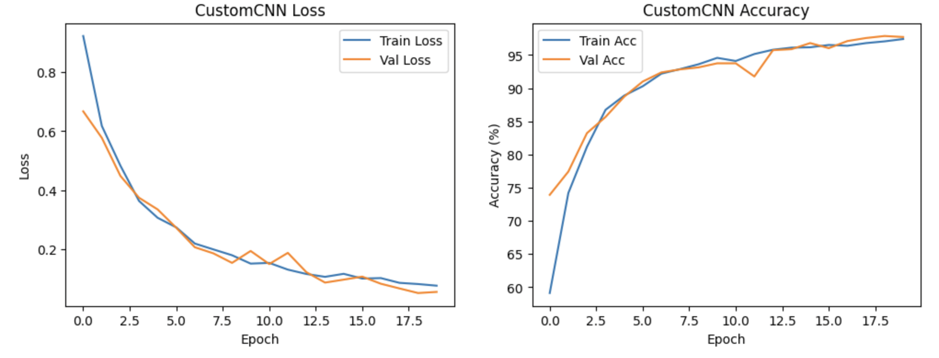
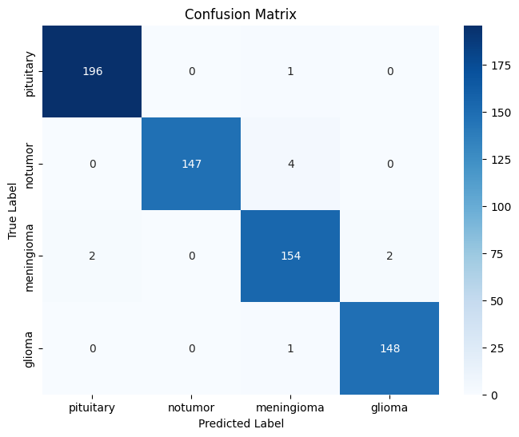
Training the model
Trained for 20 epochs at most due to validation training
Each epoch has loss and accuracy metric
If the current epoch has a record accuracy, save that version of the model.
Failure to improve in 7 epochs would prematurely end training

Slide 6

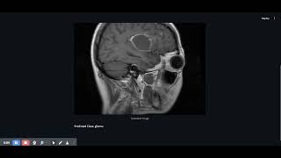
Demo

Slide 7
Thank you!

